Slide 1

Simple Calculator GUI Using Tkinter in Python

Slide 2
Presented by :
Riya Gadia
Affiliated by :DigiCrome Academy

Slide 3
Introduction
Welcome to our presentation on building a simple calculator GUI using Tkinter.
Tkinter is a popular Python library for creating graphical user interfaces.
I'll walk you through the process of creating a basic calculator interface using Tkinter.
Graphical User Interface(GUI) is a form of user interface which allows users to interact with computers through visual indicators using items such as icons, menus, windows, etc.

Slide 4
Problem or Challenge Project Aims to Solve
Our project aims to address the need for a simple and user-friendly calculator interface that can perform basic arithmetic operations.
Many users require a calculator for everyday tasks, and providing a clear and intuitive interface can enhance their productivity and user experience.
By building this calculator GUI with Tkinter, we aim to simplify the process of performing calculations for users of all levels, from beginners to experienced professionals.

Slide 5
Designing the Calculator Interface
Create a simple interface with buttons arithmetic operations, and result display.
Tkinter provides widgets such as Label, Button, and Entry.
We'll arrange these widgets using grid layout for simplicity.

Slide 6
My Approach
First of all, Import the Tkinter and math libraries.
After that, Using Entry, Button, Label widgets to create a structure of the GUI
For result and output, gave command to widget and defined that command.
For square root which is the function of maths, we imported math library and defined separately.
Than packed the widgets in grid Tkinter's mainloop() function will be used to run the application and handle events.

Slide 7
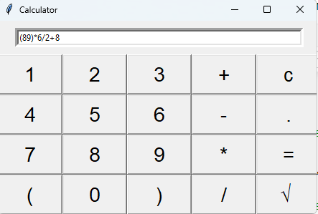
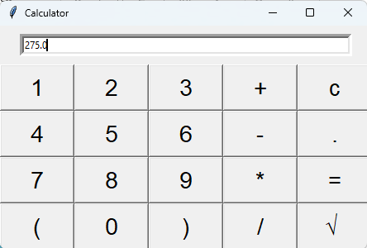
Calculator GUI

Slide 8
Conclusion
Building a simple calculator GUI with Tkinter is a great way to learn about GUI programming in Python.
With Tkinter's ease of use and flexibility, you can create a variety of GUI applications.
Customize the calculator or create own GUI projects using Tkinter.

Slide 9
Entry Widget
GUI : Used Tkinter, mainloop ()

